Slide 1
ECE 532
CHAPTER 2: FUNDAMENTAL DATA STRUCTURES: LINKED LIST (SINGLY-LINKED LIST PART 2)
Lecturer: Dr. Roslina Mohamad
Room: Tower 2, Level 13, No:14C

Slide 2
Learning Outcomes
At the end of this lecture, you will be able to:
Learn about linked lists
Become aware of the basic properties of linked lists
Explore the insertion and deletion operations on linked lists
Discover how to build and manipulate a linked list

Slide 3
Linked List Operations
Basic operations:
add a node to the end of the list
insert a node within the list
traverse the linked list
Delete/remove a node from the list
delete/destroy the list

Slide 4
Singly-linked list. Removal (deletion) operation
There are four cases:
Remove node when list have only one node
Remove first node
Remove last node
Remove in between node

Slide 5
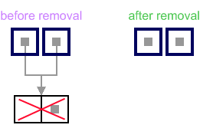
List has only one node
When list has only one node, which is indicated by the condition (head ==tail), the removal is quite simple. Algorithm disposes the node, pointed by head (or tail) and sets both head and tail to NULL
//See Example 2.21

Slide 6
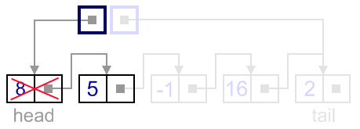
Remove First Node
In this case, first node (current head node) is removed from the list.

Slide 7
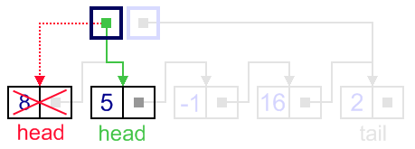
Remove First Node
It can be done in two steps:
Update head link to point to the node, next to the head.

Slide 8
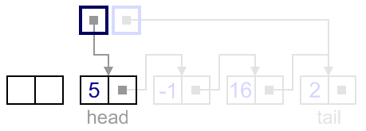
Remove First Node
Dispose removed node.
//See Example 2.22

Slide 9
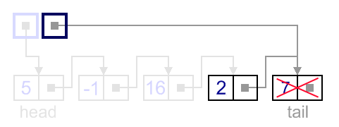
Remove Last Node
In this case, last node (current tail node) is removed from the list. This operation is a bit more tricky, than removing the first node, because algorithm should find a node, which is previous to the tail first.

Slide 10
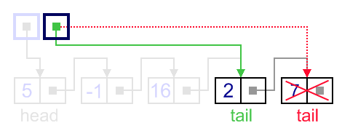
Remove Last Node
It can be done in three steps:
Update tail link to point to the node, before the tail. In order to find it, list should be traversed first, beginning from the head.

Slide 11
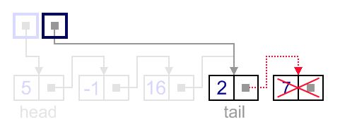
Remove Last Node
Set next link of the new tail to NULL

Slide 12
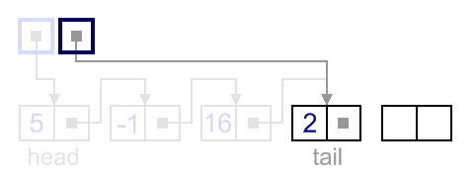
Remove Last Node
Dispose removed node.
//See Example 2.23

Slide 13
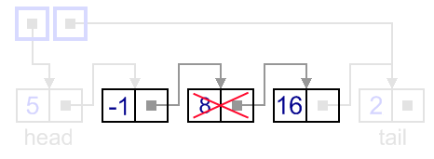
Remove in between Node
In general case, node to be removed is always located between two list nodes. Head and tail links are not updated in this case.

Slide 14
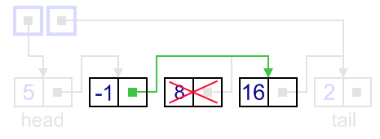
Remove in between Node
Such a removal can be done in two steps:
Update next link of the previous node, to point to the next node, relative to the removed node.

Slide 15
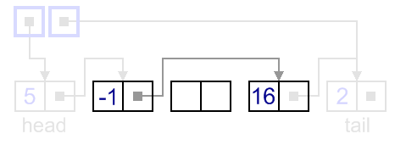
Remove in between Node
Dispose removed node.
//See Example 2.24

Slide 16
Variations of the Linked List
Other linked list organizations:
doubly-linked list: each node contains two pointers: one to the next node in the list, one to the previous node in the list
5
13
19
NULL
list
head
NULL

Slide 17
Variations of the Linked List
Other linked list organizations:
circular linked list: the last node in the list points back to the first node in the list, not to NULL
5
13
19
list
head

